Slide 1
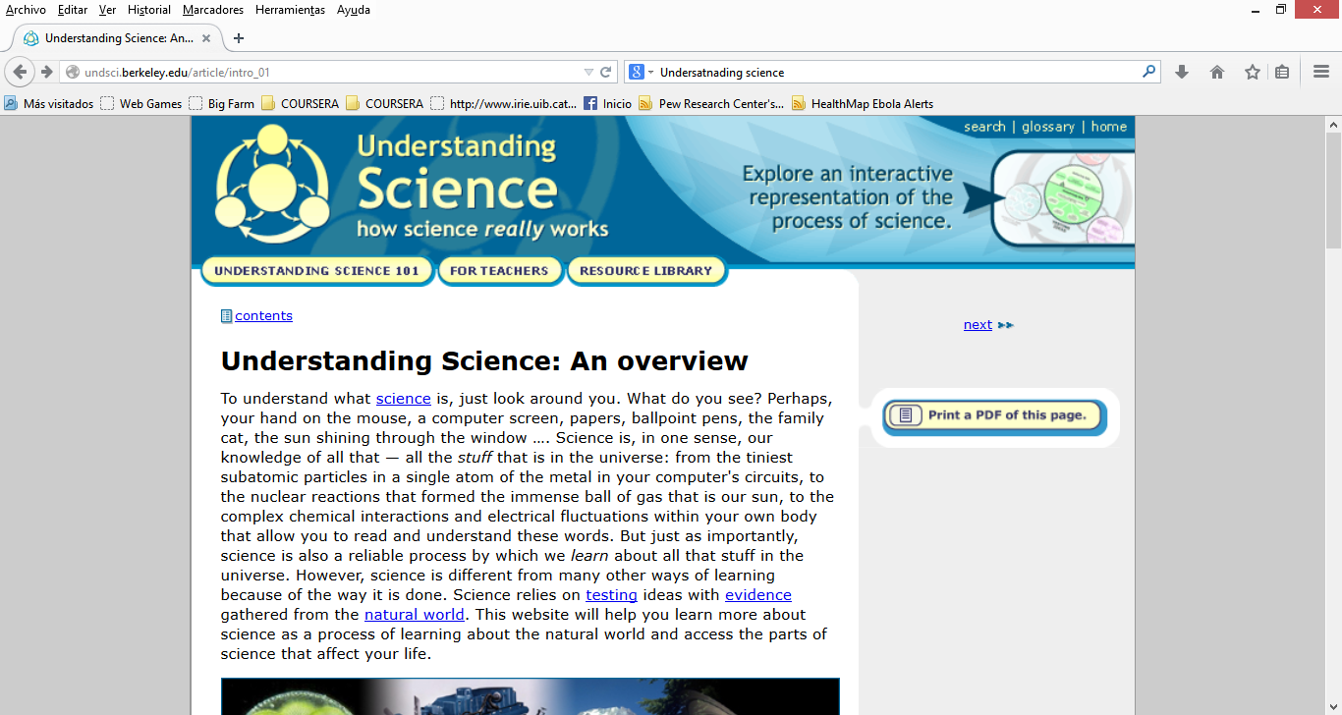
Understanding science, how science really works
Universitat de Berkeley, California, USA
http://undsci.berkeley.edu/article/intro_01

