Slide 1
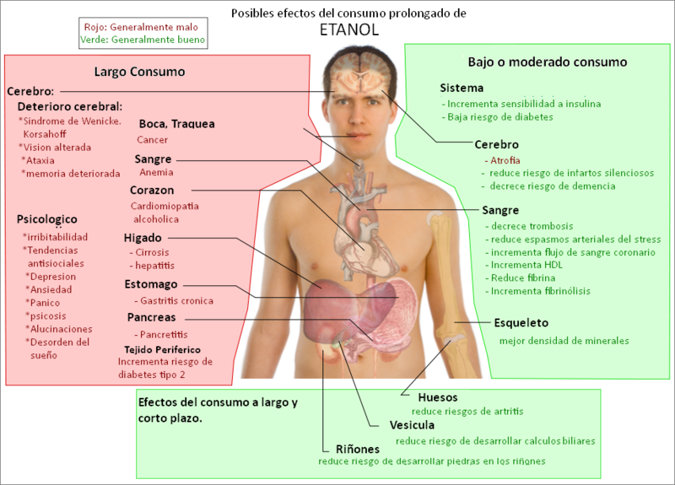

Slide 2
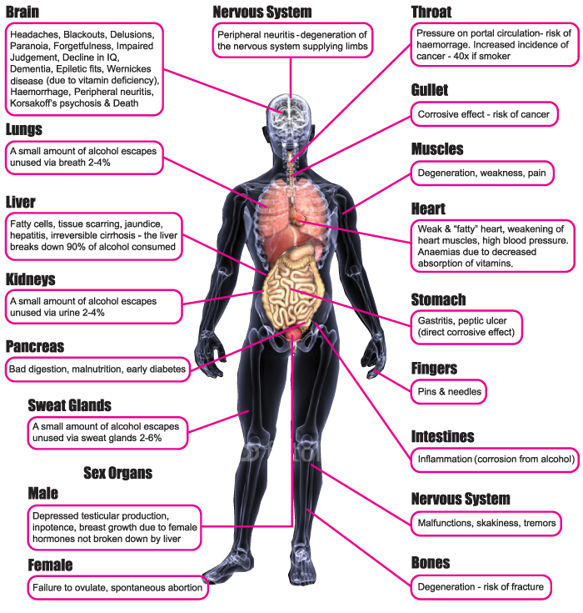
http://www.alcoholservices-ateam.org.uk/effects_of_alcohol.html

Slide 3
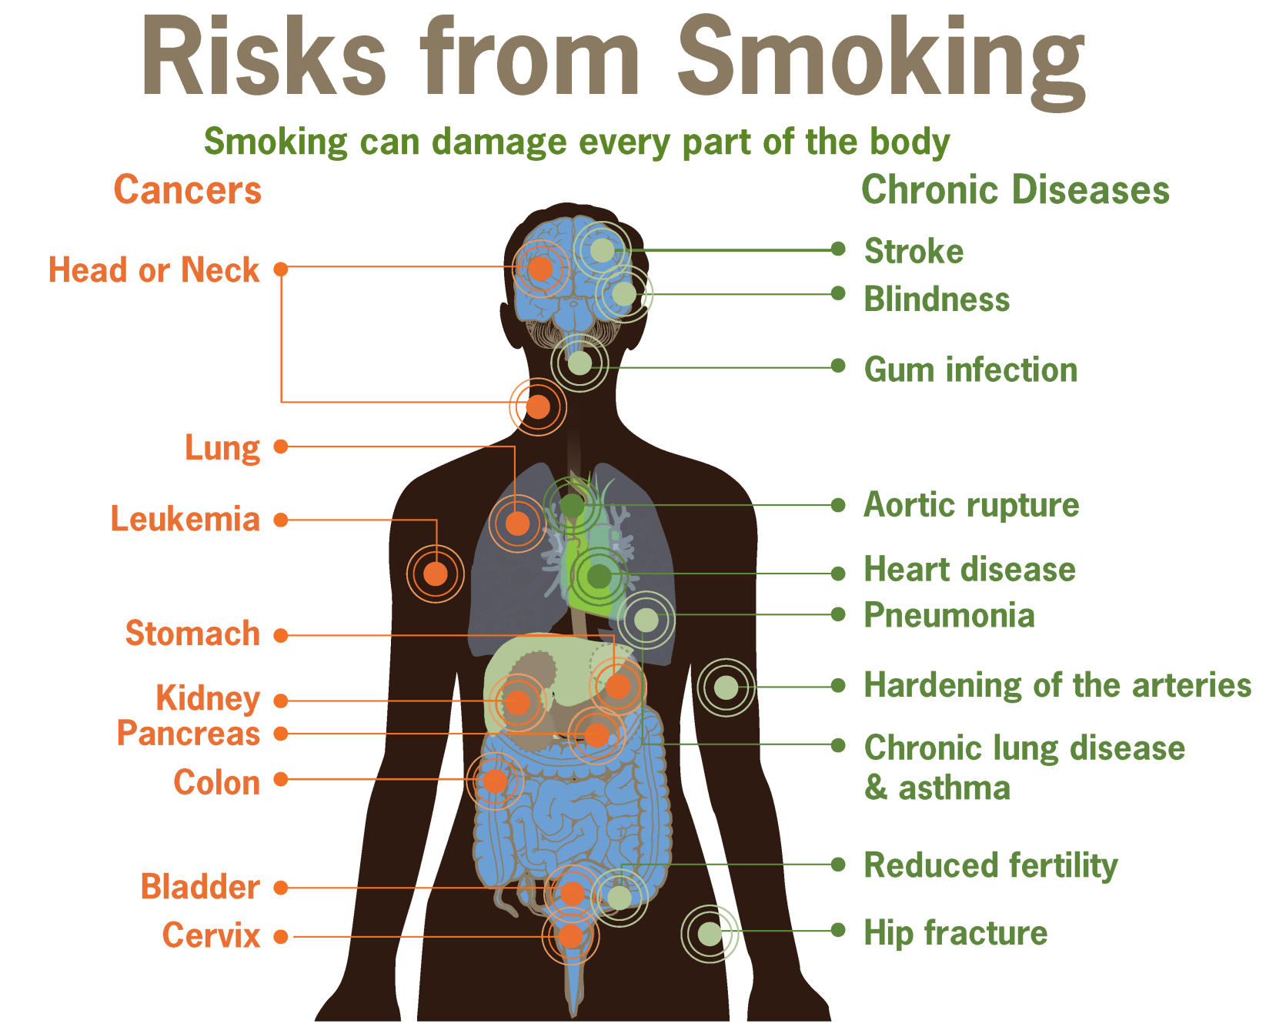

Slide 4
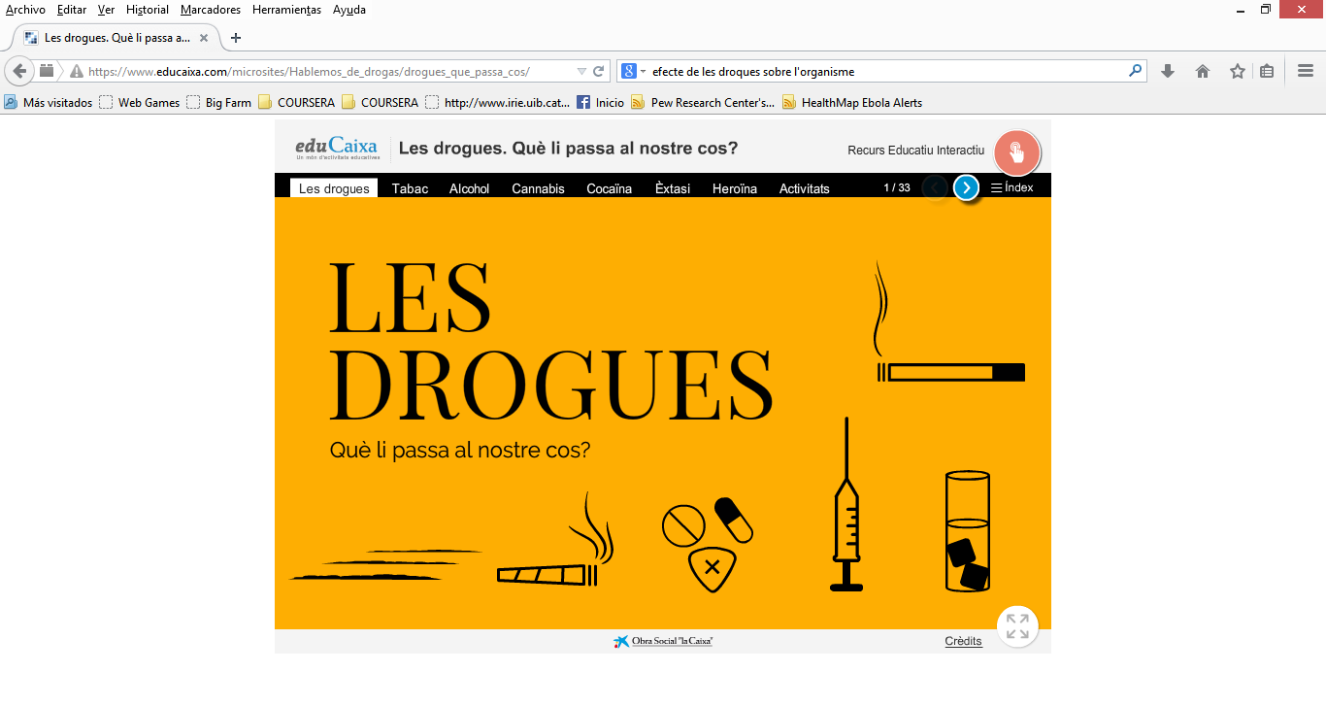
https://www.educaixa.com/microsites/Hablemos_de_drogas/drogues_que_passa_cos/

Slide 5
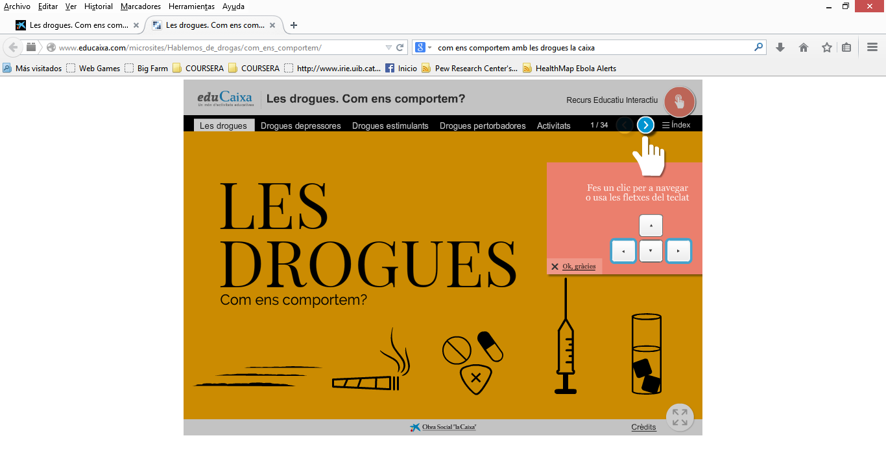
http://www.educaixa.com/microsites/Hablemos_de_drogas/com_ens_comportem/

