Slide 1
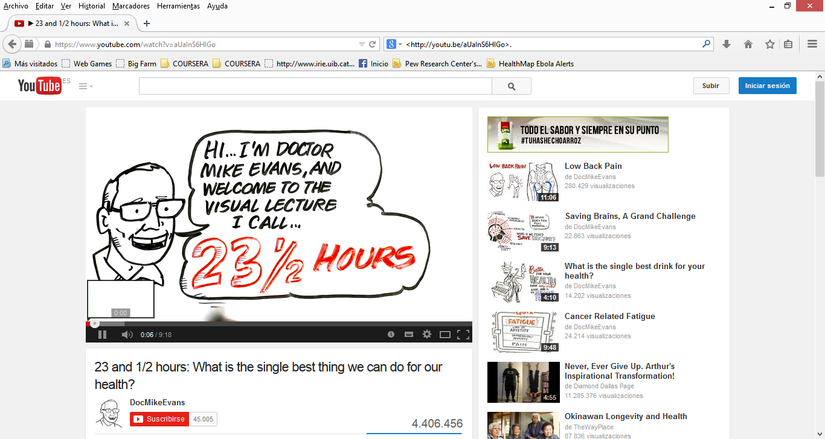
https://www.youtube.com/watch?v=aUaInS6HIGo

