Slide 1
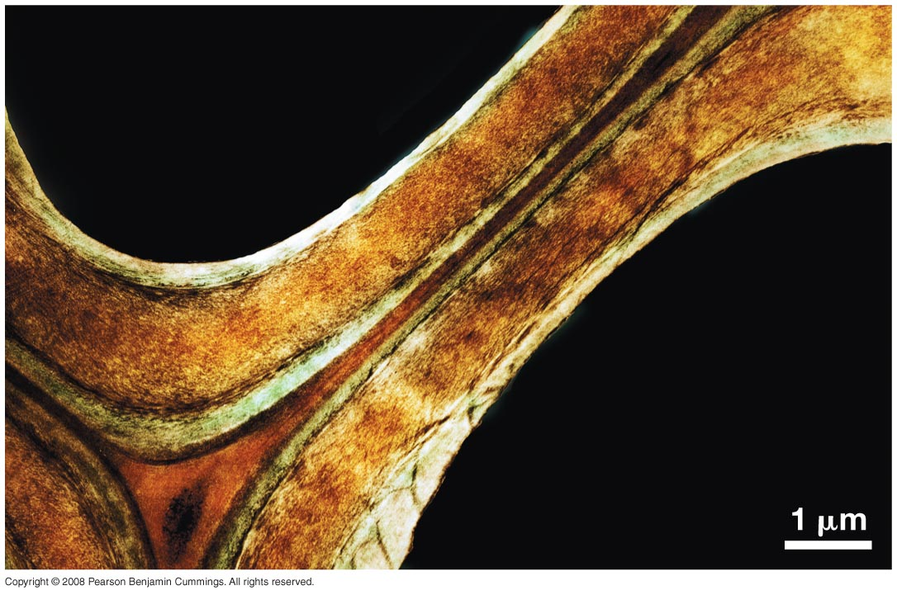
Paret cel·lular
Primary cell
walls
Middle lamella

Slide 2
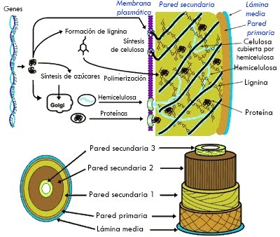

Slide 3
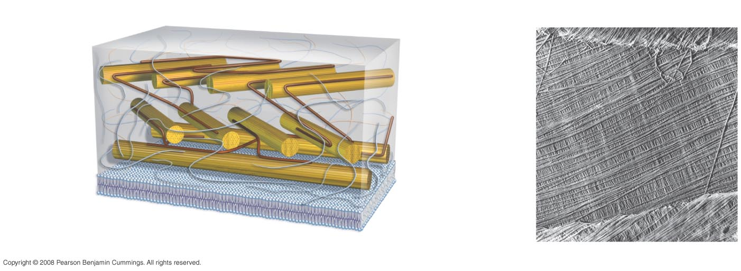
Primary Cell Walls of Plants Are Fiber Composites
Side view
Top view
Cellulose
microfibril
Primary
cell wall
Pectin
Plasma
membrane
Cross-links

Slide 4
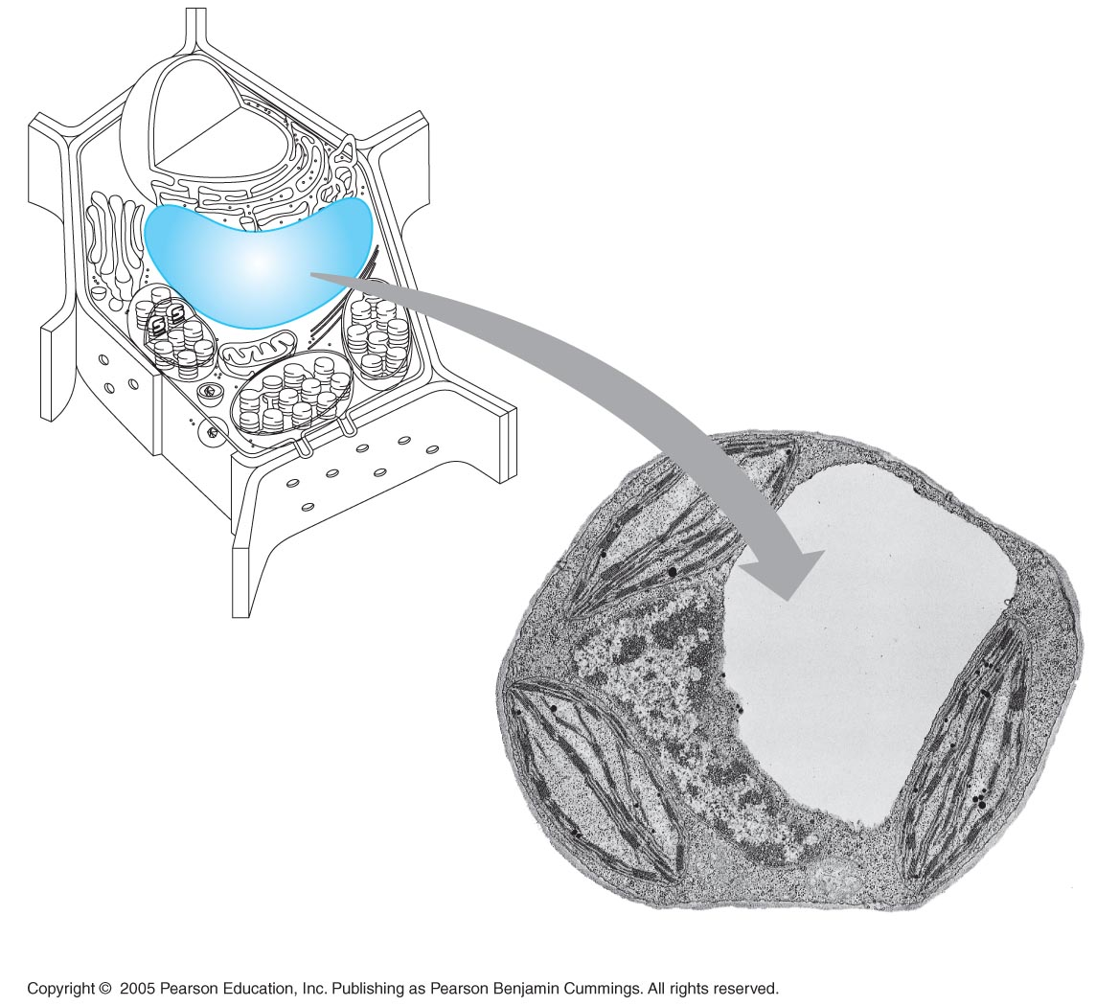
LE 6-15
Vacuola vegetal
Central vacuole
Cytosol
Tonoplast
Nucleus
Central
vacuole
Cell wall
Chloroplast
5 µm

Slide 5
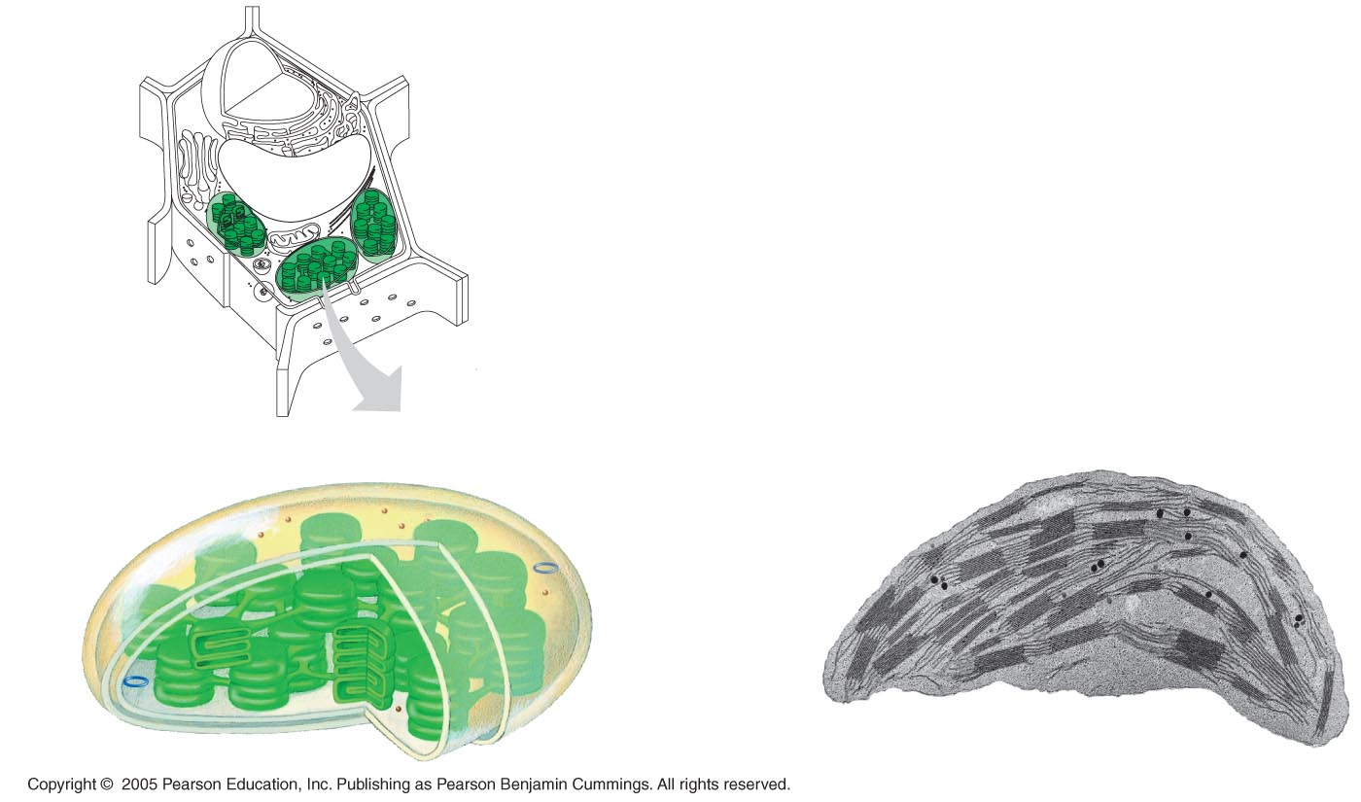
LE 6-18
Cloroplasts
Chloroplast
Ribosomes
Stroma
Chloroplast
DNA
Inner and outer
membranes
Granum
1 µm
Thylakoid

