Slide 1
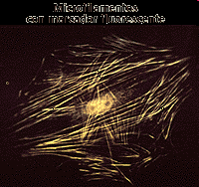
Citoesquelet

Slide 2
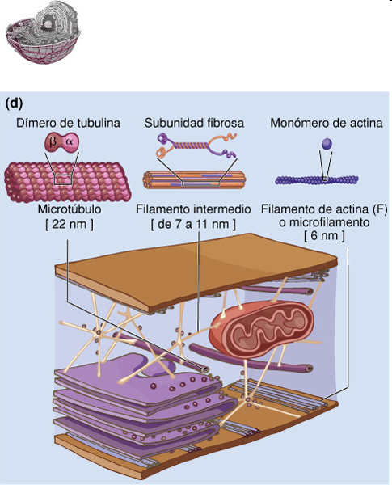
Citoesquelet

Slide 3
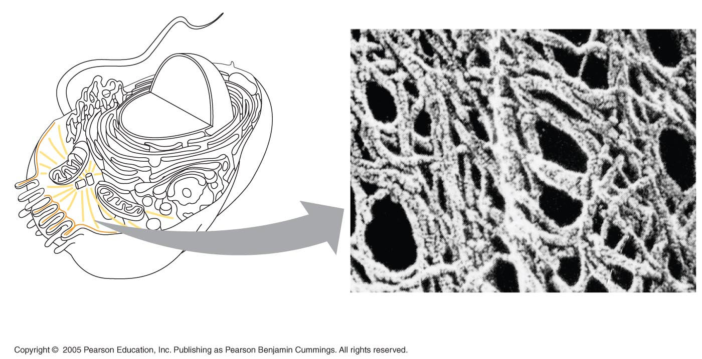
LE 6-20
Citoesquelet
Microtubule
Microfilaments
0.25 µm

Slide 4
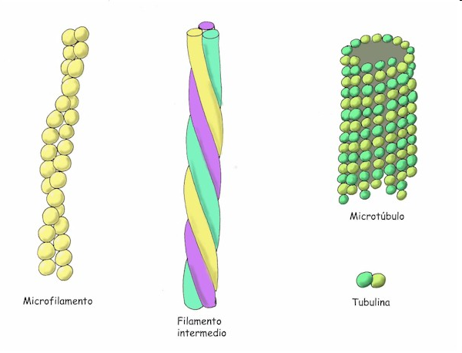

Slide 6
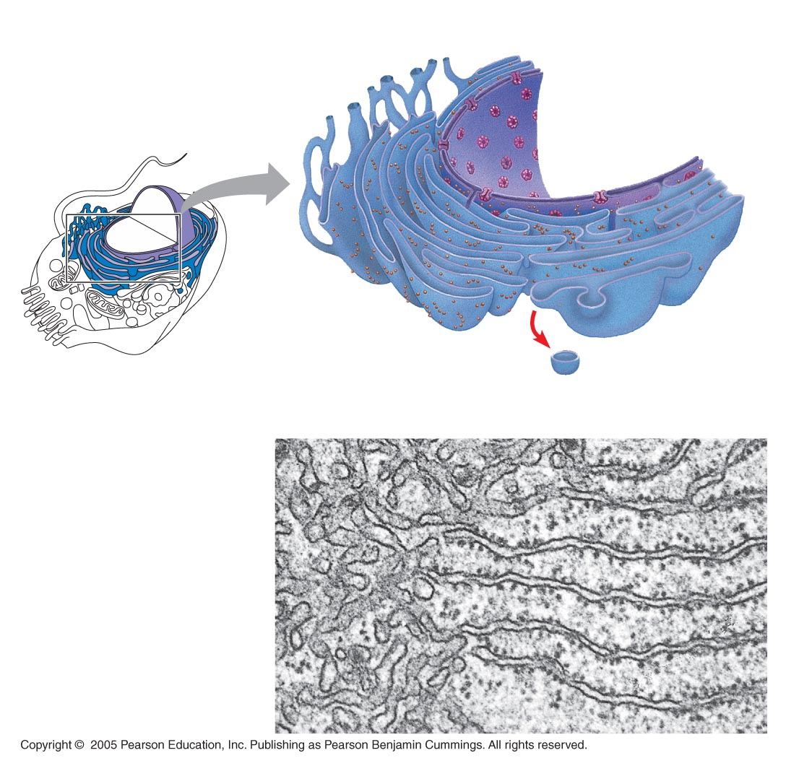
LE 6-12
Smooth ER
Reticle endoplasmàtic
Rough ER
Nuclear
envelope
ER lumen
Cisternae
Ribosomes
Transitional ER
Transport vesicle
Smooth ER
Rough ER
200 nm

Slide 7
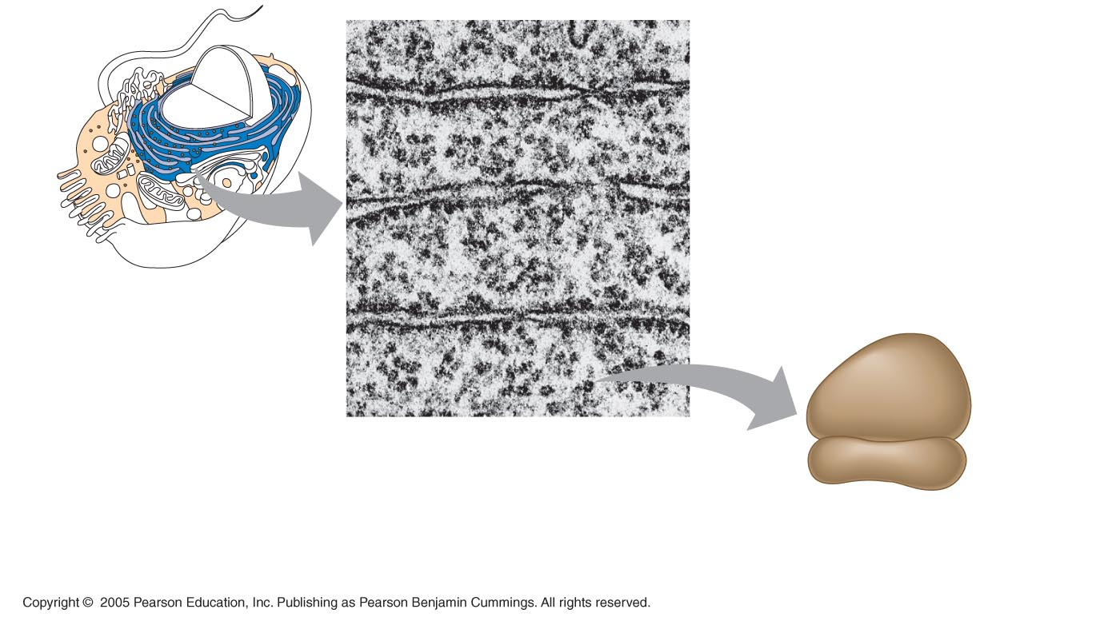
LE 6-11
Ribosomes
ER
Cytosol
Endoplasmic
reticulum (ER)
Free ribosomes
Bound ribosomes
Large
subunit
0.5 µm
Small
subunit
TEM showing ER
and ribosomes
Diagram of
a ribosome

Slide 8
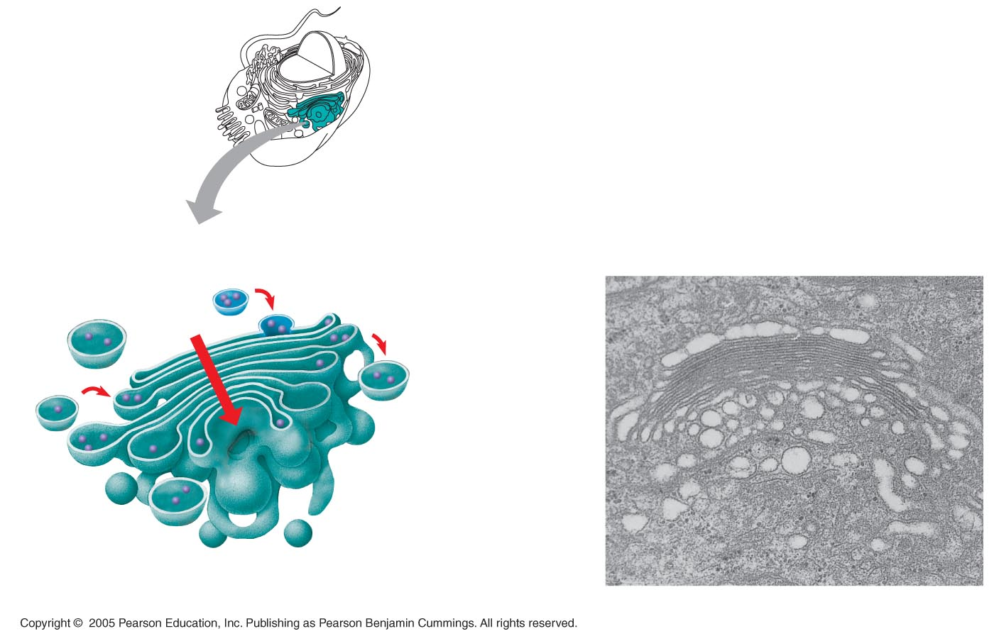
LE 6-13
Sistema de Golgi
Golgi
apparatus
cis face
(“receiving” side of
Golgi apparatus)
Vesicles move
from ER to Golgi
Vesicles coalesce to
form new cis Golgi cisternae
0.1 µm
Vesicles also
transport certain
proteins back to ER
Cisternae
Cisternal
maturation:
Golgi cisternae
move in a cis-
to-trans
direction
Vesicles form and
leave Golgi, carrying
specific proteins to
other locations or to
the plasma mem-
brane for secretion
Vesicles transport specific
proteins backward to newer
Golgi cisternae
trans face
(“shipping” side of
Golgi apparatus)
TEM of Golgi apparatus

Slide 9
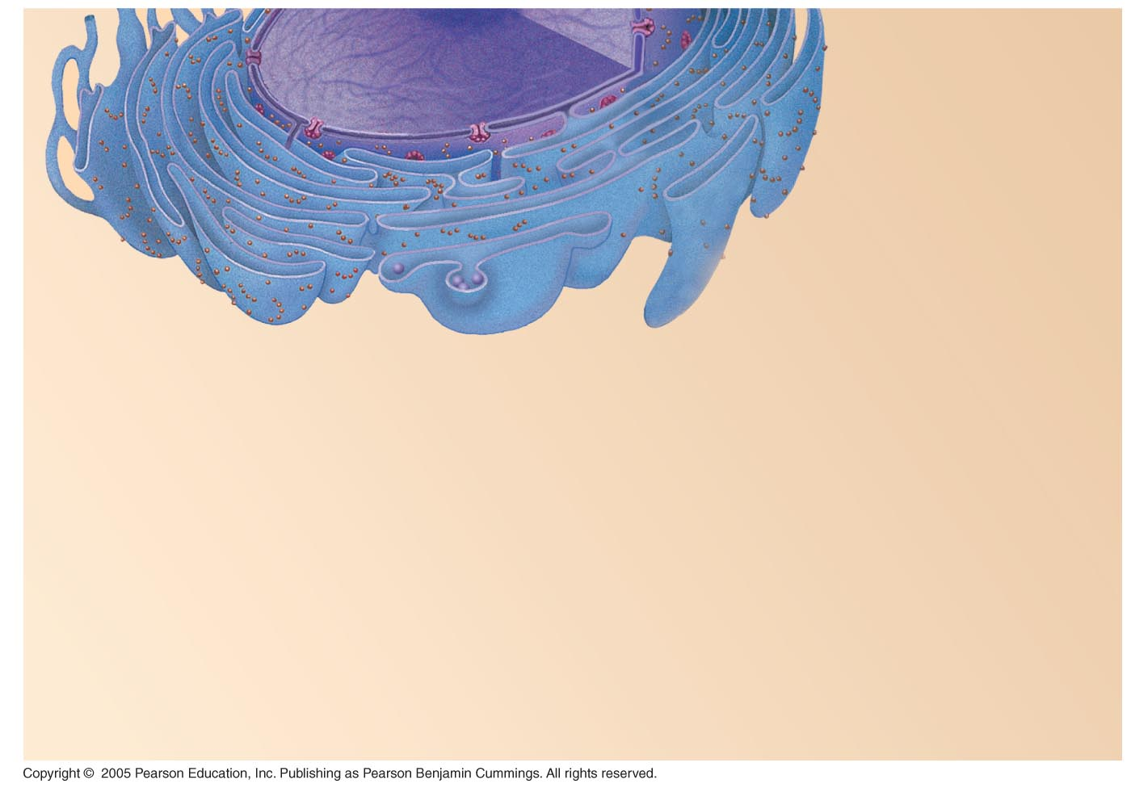
LE 6-16-1
Nucleus
Rough ER
Smooth ER
Nuclear envelope

Slide 10
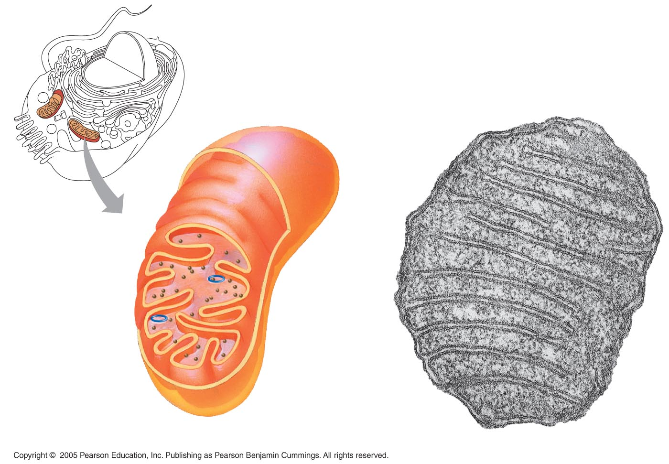
LE 6-17
Mitocondris
Mitochondrion
Intermembrane space
Outer
membrane
Free
ribosomes
in the
mitochondrial
matrix
Inner
membrane
Cristae
Matrix
Mitochondrial
DNA
100 nm

Slide 11
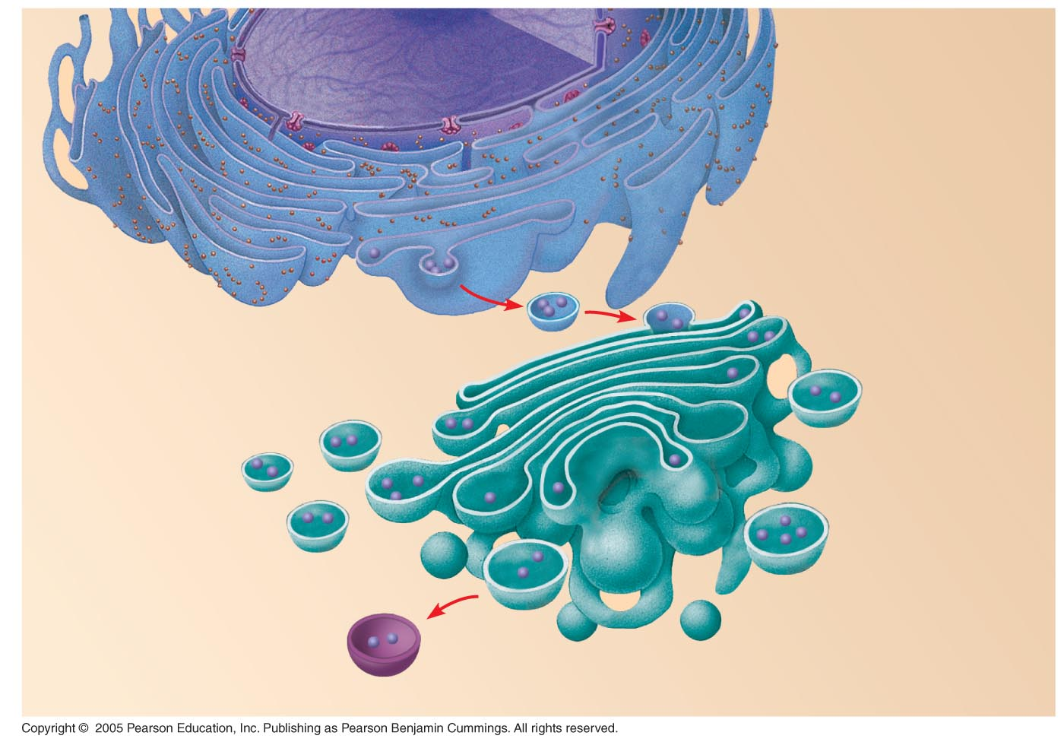
LE 6-16-2
Nucleus
Rough ER
Smooth ER
Nuclear envelope
cis Golgi
Transport vesicle
trans Golgi

Slide 12
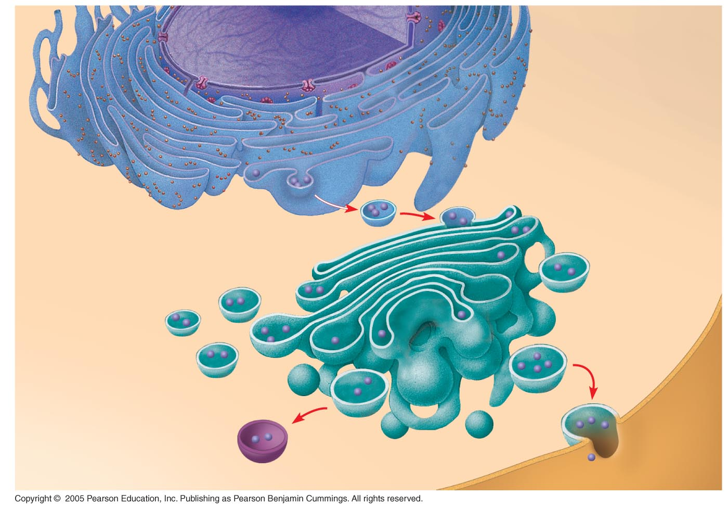
LE 6-16-3
Nucleus
Rough ER
Smooth ER
Nuclear envelope
cis Golgi
Transport vesicle
Plasma
membrane
trans Golgi

Slide 13
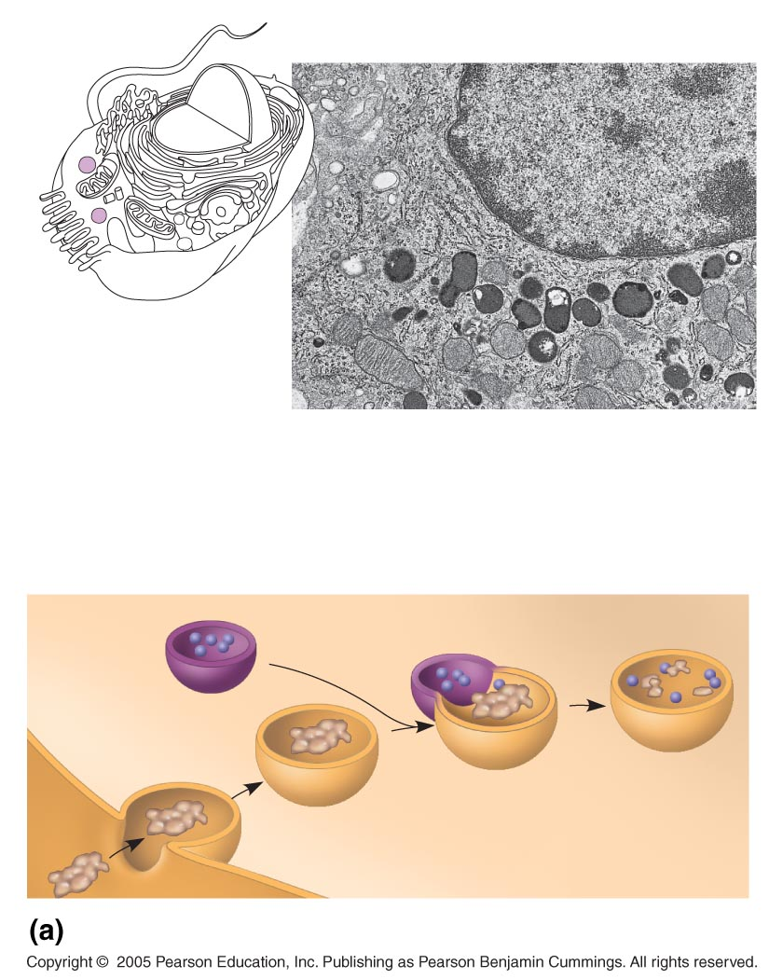
LE 6-14a
Nucleus
1 µm
Lysosome
Lysosome contains
active hydrolytic
enzymes
Food vacuole
fuses with
lysosome
Hydrolytic
enzymes digest
food particles
Plasma
membrane
Digestive
enzymes
Lysosome
Digestion
Food vacuole
Phagocytosis: lysosome digesting food

Slide 14
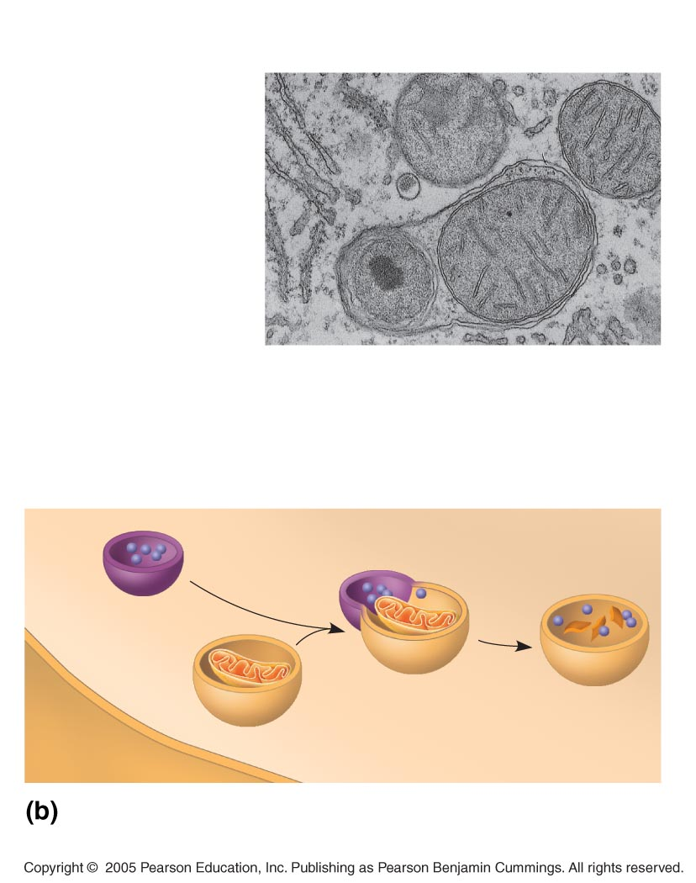
LE 6-14b
Lysosome containing
two damaged organelles
1 µm
Mitochondrion
fragment
Peroxisome
fragment
Lysosome fuses with
vesicle containing
damaged organelle
Hydrolytic enzymes
digest organelle
components
Lysosome
Digestion
Vesicle containing
damaged mitochondrion
Autophagy: lysosome breaking down
damaged organelle

Slide 15
