Slide 1
UD. IV. GENÈTICA. Ll. IV. 5. Biotecnologia
3. Anàlisi de la fragmentació de l’ADN
Una vegada aconseguida la fragmentació de l’ADN i haver-se aconseguit la replicació de molts de fragments aquests es poden començar a estudiar amb dues tècniques diferents:
- electroforesi en gel
- southern blot

Slide 2
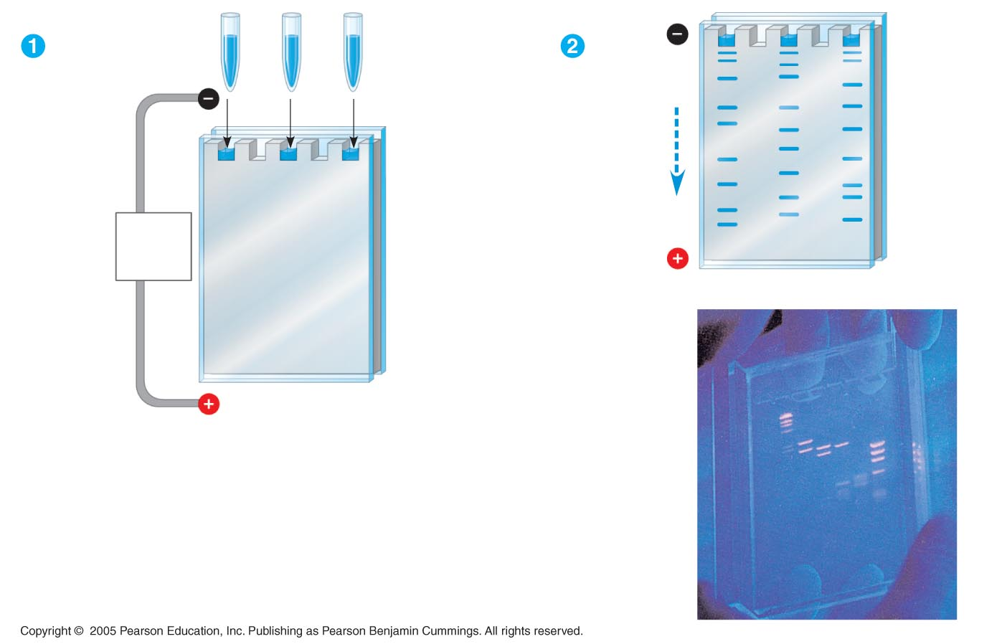
3.1. Electroforesi en gel
Mixture
of DNA
molecules
of differ-
ent sizes
Longer
molecules
Cathode
Power
source
Shorter
molecules
Gel
Glass
plates
Anode

Slide 3
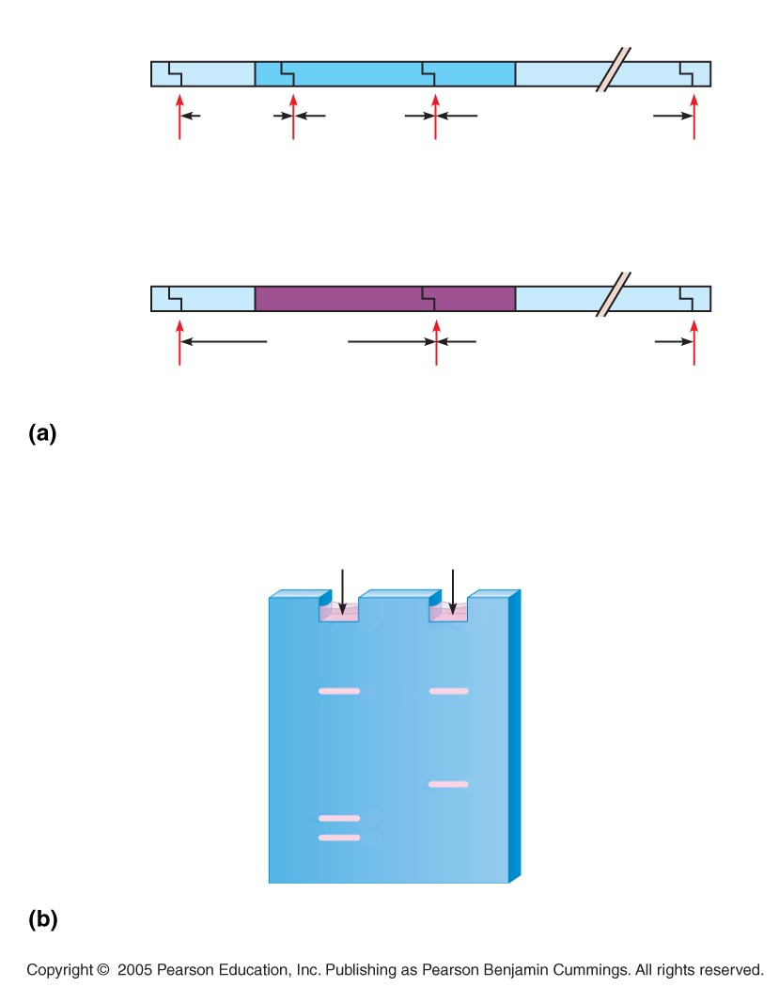
LE 20-9
Normal β-globin allele
Aplicació de l’electroforesi en gel per separar dos al·lels.
Cas de l’anèmia falciforme
175 bp
201 bp
Large fragment
Ddel
Ddel
Ddel
Ddel
Sickle-cell mutant β-globin allele
376 bp
Large fragment
Ddel
Ddel
Ddel
Ddel restriction sites in normal and sickle-cell alleles of
β-globin gene
Normal
allele
Sickle-cell
allele
Large
fragment
376 bp
201 bp
175 bp
Electrophoresis of restriction fragments from normal
and sickle-cell alleles

Slide 4
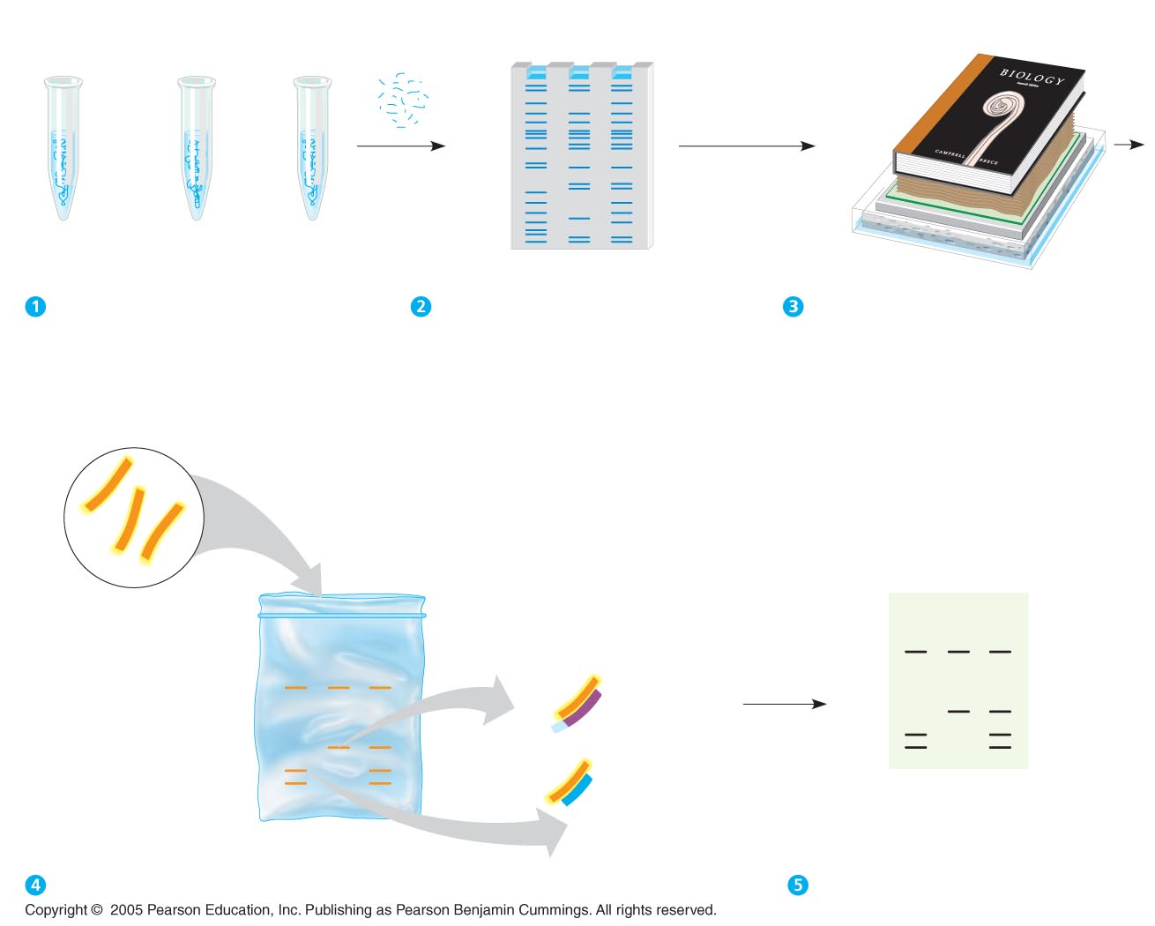
3.2. Southern blot
Heavy
weight
DNA + restriction enzyme
Restriction
fragments
Ι
ΙΙ
ΙΙΙ
Nitrocellulose
paper (blot)
Gel
Sponge
Ι Normal
β-globin
allele
ΙΙ Sickle-cell
allele
ΙΙΙ Heterozygote
Paper
towels
Alkaline
solution
Preparation of restriction fragments.
Gel electrophoresis.
Blotting.
Probe hydrogen-
bonds to fragments
containing normal
or mutant β-globin
Radioactively
labeled probe
for β-globin
gene is added
to solution in
a plastic bag
Ι
ΙΙ
ΙΙΙ
Ι
ΙΙ
ΙΙΙ
Fragment from
sickle-cell
β-globin allele
Film over
paper blot
Fragment from
normal β-globin
allele
Paper blot
Hybridization with radioactive probe.
Autoradiography.

