Slide 1
UD. IV. GENÈTICA. Ll. IV. 5. Biotecnologia
4. Estudi de la seqüència d’ADN. Mètode didesoxi.

Slide 2
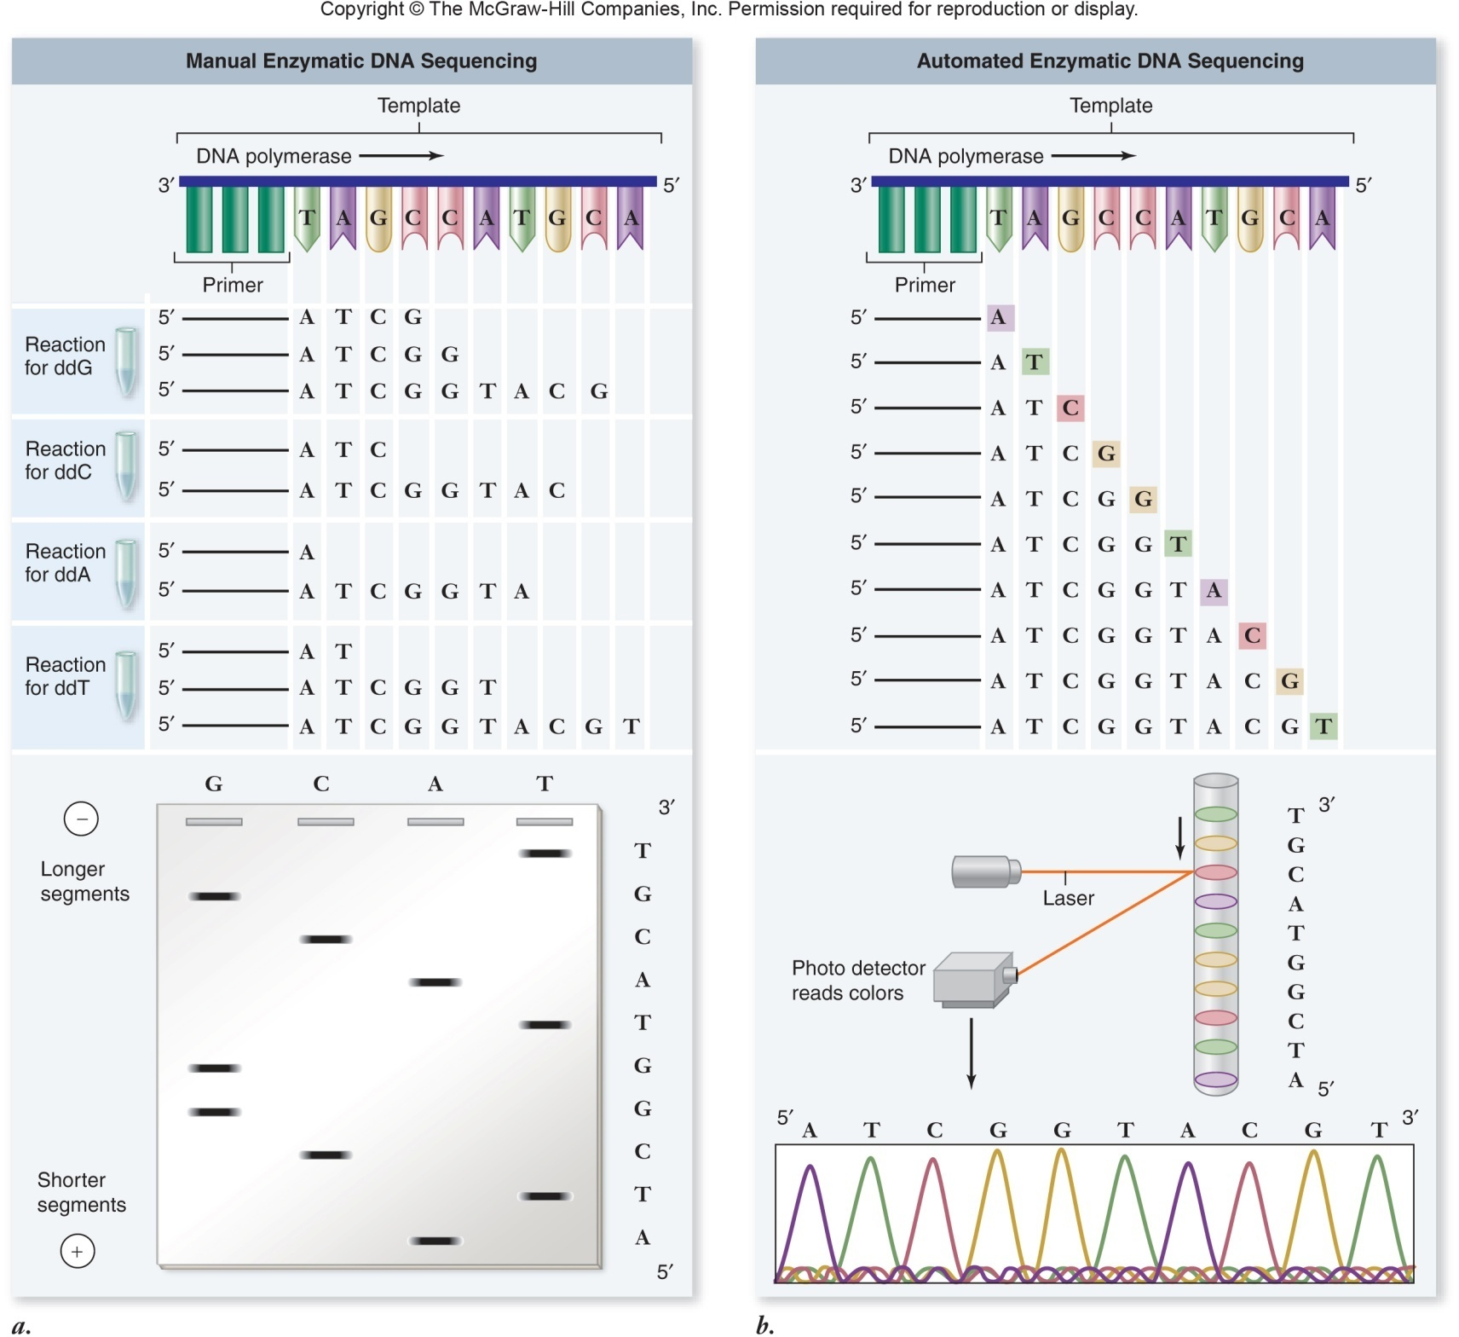

Slide 3
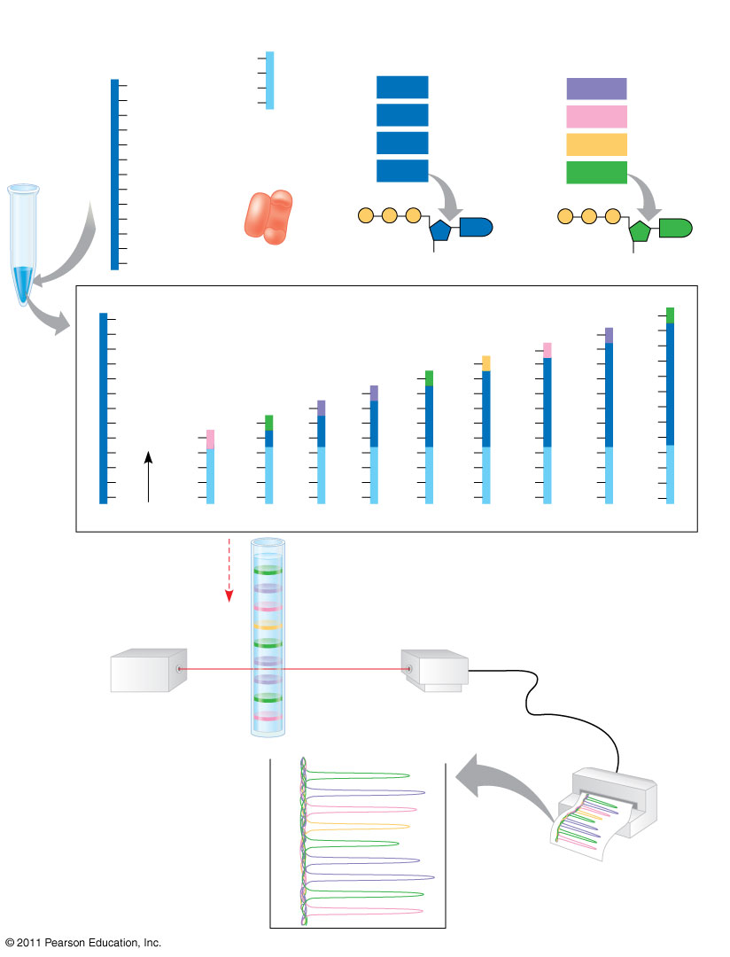
Figure 20.12
TECHNIQUE
DNA (template strand)
Primer
Deoxyribonucleotides
Dideoxyribonucleotides (fluorescently tagged)
T
3′
5′
C
G
T
T
dATP
ddATP
G
T
5′
dCTP
ddCTP
A
DNA polymerase
dTTP
C
ddTTP
T
dGTP
T
ddGTP
C
G
P
P
P
P
P
P
A
G
G
C
3′
A
OH
H
A
5′
DNA (template strand)
Labeled strands
3′
C
ddG
T
ddA
A
G
ddC
C
C
A
ddT
T
T
T
C
ddG
G
G
G
G
T
ddA
A
A
A
A
A
T
ddA
A
A
A
A
A
A
C
ddG
G
G
G
G
G
G
G
G
ddC
C
C
C
C
C
C
C
C
A
T
T
T
T
T
T
T
T
T
T
T
T
C
G
G
T
T
T
T
T
G
A
T
G
T
G
G
G
G
G
T
3′
T
T
T
T
T
T
T
T
T
5′
A
Shortest
T
T
T
T
T
T
Longest
Direction of movement of strands
Longest labeled strand
Detector
Laser
Shortest labeled strand
RESULTS
Last nucleotide of longest labeled strand
G
A
C
T
G
Last nucleotide of shortest labeled strand
A
A
G
C
Notes:
Figure 20.12 Research Method: Dideoxy Chain Termination Method for Sequencing DNA

Slide 4
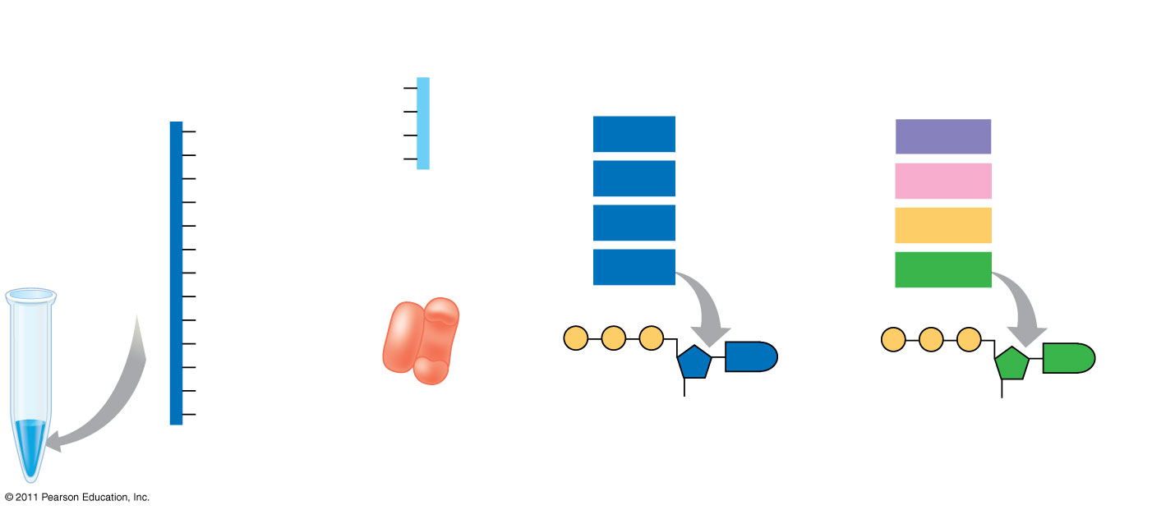
Figure 20.12a
TECHNIQUE
DNA (template strand)
Primer
Deoxyribonucleotides
Dideoxyribonucleotides (fluorescently tagged)
T
3′
5′
G
C
T
dATP
ddATP
T
T
5′
G
dCTP
ddCTP
A
DNA polymerase
C
dTTP
ddTTP
T
T
dGTP
ddGTP
C
G
P
P
P
A
G
P
P
P
C
G
A
3′
A
OH
H
Notes:
Figure 20.12 Research Method: Dideoxy Chain Termination Method for Sequencing DNA

Slide 5
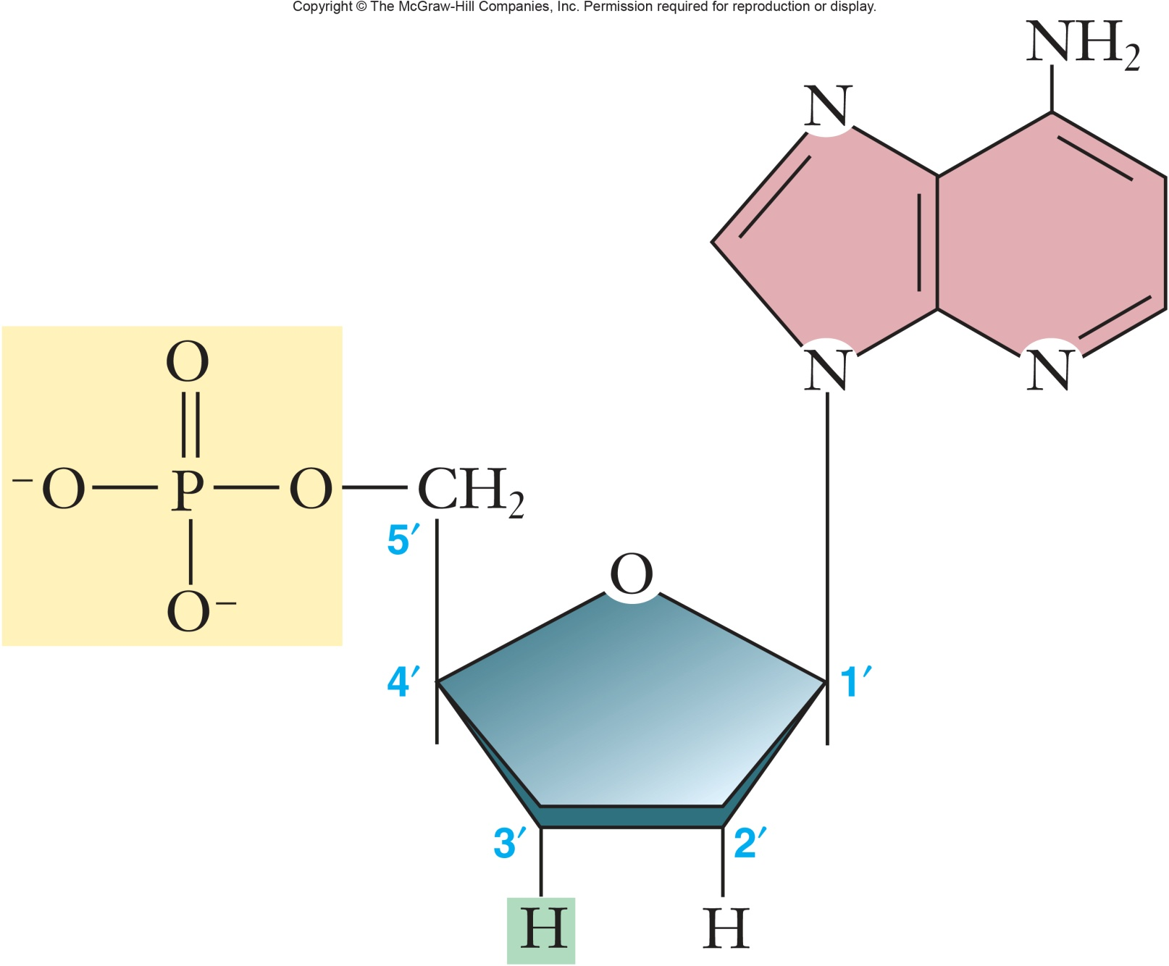
didesoxinucleòtid

Slide 6
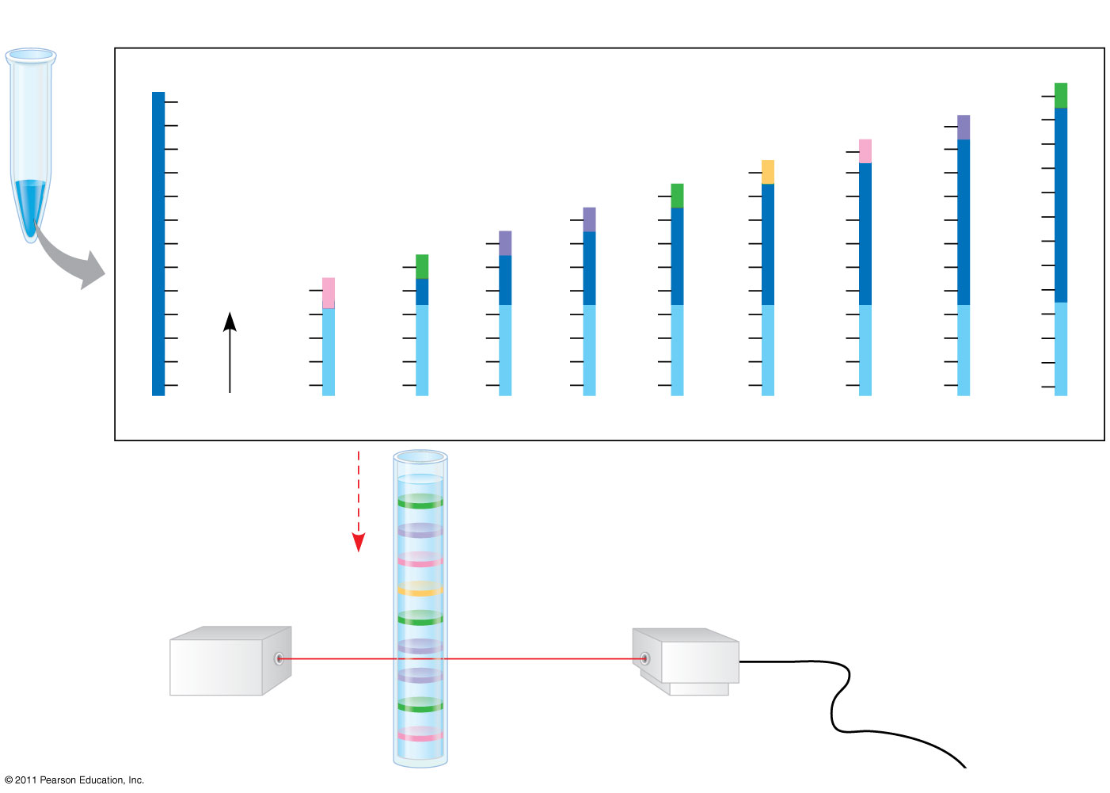
Figure 20.12b
TECHNIQUE (continued)
DNA (template strand)
Labeled strands
3′
5′
C
ddG
T
ddA
A
G
ddC
C
C
A
ddT
T
T
T
C
ddG
G
G
G
G
T
ddA
A
A
A
A
A
T
ddA
A
A
A
A
A
A
C
ddG
G
G
G
G
G
G
G
G
ddC
C
C
C
C
C
C
C
C
A
T
T
T
T
T
T
T
T
T
C
G
G
G
G
G
G
G
G
G
A
T
T
T
T
T
T
T
T
T
3′
A
T
T
T
T
T
T
T
T
T
5′
Shortest
Longest
Direction of movement of strands
Longest labeled strand
Detector
Laser
Shortest labeled strand
Notes:
Figure 20.12 Research Method: Dideoxy Chain Termination Method for Sequencing DNA

Slide 7
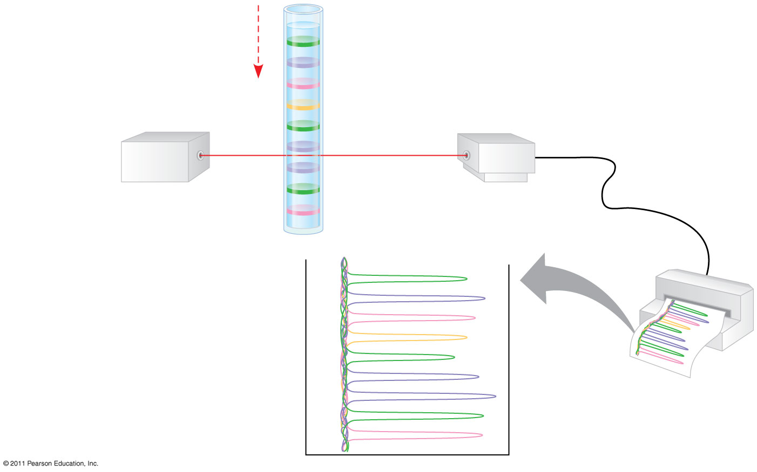
Figure 20.12c
Direction of movement of strands
Longest labeled strand
Detector
Laser
Shortest labeled strand
RESULTS
Last nucleotide of longest labeled strand
G
A
C
T
G
Last nucleotide of shortest labeled strand
A
A
G
C
Notes:
Figure 20.12 Research Method: Dideoxy Chain Termination Method for Sequencing DNA

