Slide 1
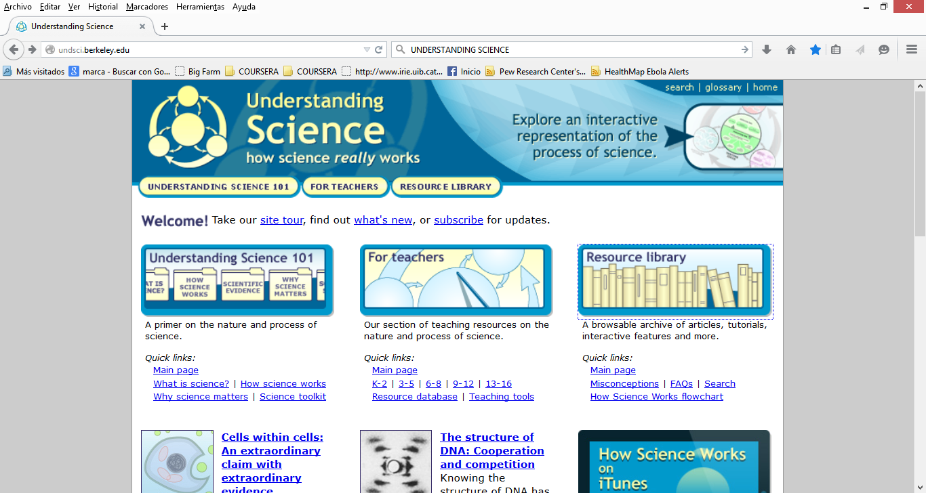
Understanding Science, http://undsci.berkeley.edu/

Slide 2
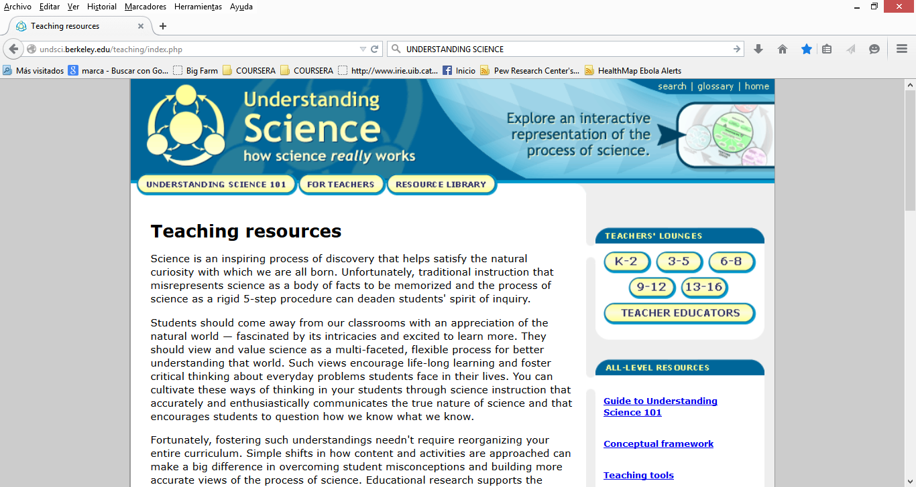

Slide 3
