Slide 1
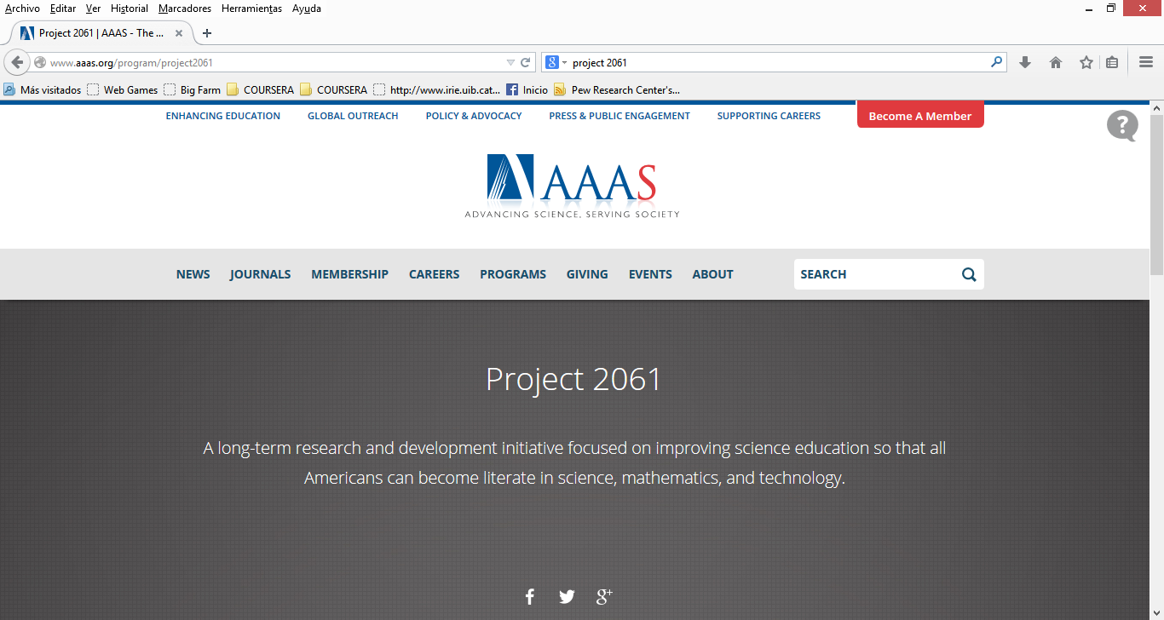
http://www.aaas.org/program/project2061

Slide 2
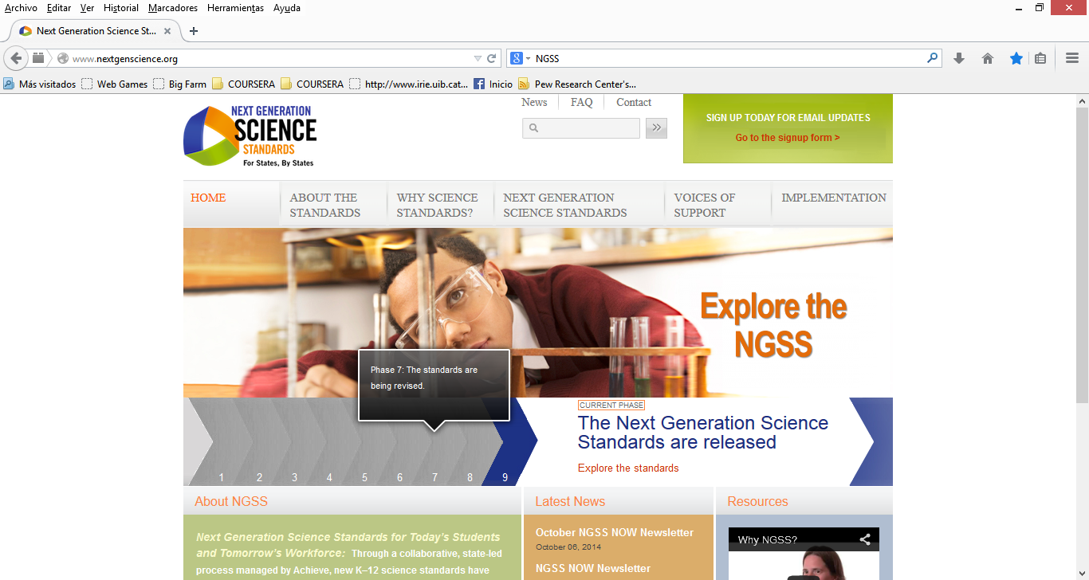
http://www.nextgenscience.org/

Slide 3
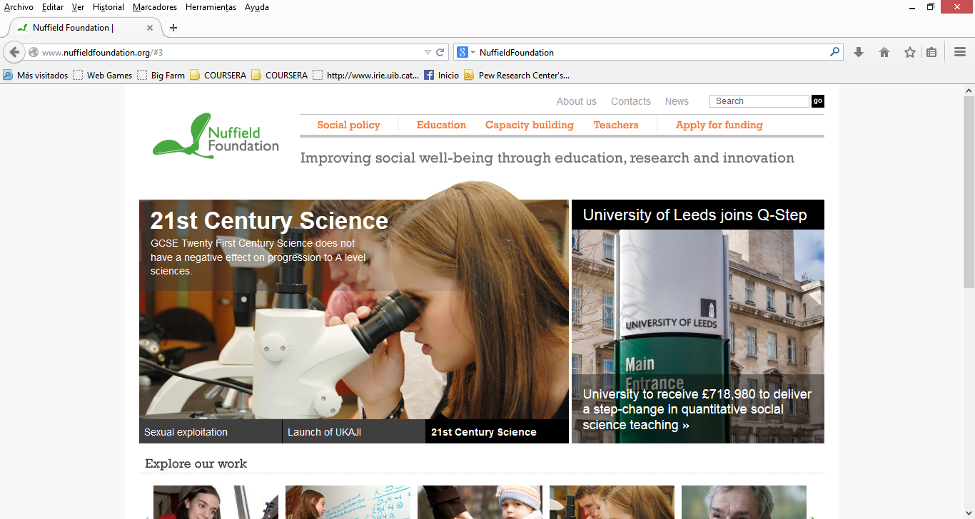
http://www.nuffieldfoundation.org/#3

Slide 4

http://www.fundacion.telefonica.com/es/arte_cultura/publicaciones/detalle/307#

